Slide 1
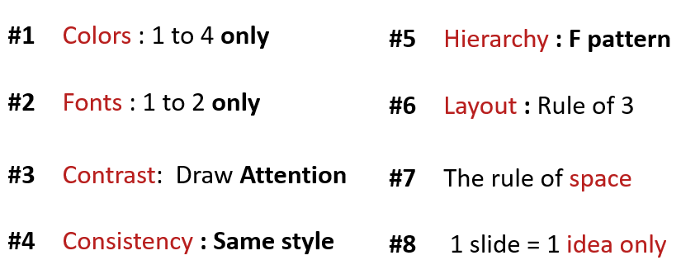
ACTIVITY 1
Analyze the 3 slides
Why they respect the design principle?

Slide 2
Computer / Database Diagram
Marketing is the study and management of exchange relationships. Marketing is the business process of creating relationships with and satisfying customers.
Analyze
Promotions only work as well as the marketing, to get your company’s.
+35
To get your company’s name out there.
Advertise
Promotions only work as well as the marketing, to get your company’s.
+10
To get your company’s name out there.
Identify
Promotions only work as well as the marketing, to get your company’s.

Slide 3
Why they respect the design principle?
First slide
Color | They use only 3 color that make this slide not messy
Font | For the font they use only 2 fonts that are related in on group of the font
Contrast | They use contrast with the icon and contrast with the title
Hierarchy | They also use F pattern that make visual easy to look and know where they should see first.
The rule of space | For this rule they use white space and has white space from 1 sentence to other sentence and it balance
1 slide 1 idea | Use 1 idea in one slide

Slide 4
Comparison Chart
Marketing is the study and management of exchange relationships. Marketing is the business process of creating relationships with and satisfying customers.
Develop
Analyze
Promotions only work as well as the marketing. Promotions only work as well as the marketing.
vs.
Promotions only work as well as the marketing. Promotions only work as well as the marketing.
Promotions only work as well as the marketing.
Promotions only work as well as the marketing.
DEVELOP
DEVELOP
ANALYZE
ANALYZE
Promotions only work as well as the marketing.
Promotions only work as well as the marketing.
IDENTIFY
IDENTIFY

Slide 5
Why they respect the design principle?
Second slide
Color | They use only 3 color that make this slide not messy
Font | For the font they use only 2 fonts that are related in on group of the font
Contrast | They use contrast with the icon and contrast with the title
Hierarchy | They also use F pattern that make visual easy to look and know where they should see first.
The rule of space | For this rule they use white space and has white space from 1 sentence to other sentence and it balance
1 slide 1 idea | Use 1 idea in one slide
Layout | They use

Slide 6
Title One
Promotions only work
as well as the marketing.
Title Two
Promotions only work
as well as the marketing.
Business
Infographics
Title Three
Promotions only work
as well as the marketing.
Marketing is the study and management
of exchange relationships.
Title Four
Promotions only work
as well as the marketing.
Title Five
Promotions only work
as well as the marketing.

Slide 7
Why they respect the design principle?
Second slide
Color | They use only 3 color that make this slide not messy
Font | For the font they use only 2 fonts that are related in on group of the font
Contrast | They use contrast with the icon and contrast with the title
Hierarchy | They also use F pattern that make visual easy to look and know where they should see first.
The rule of space | For this rule they use white space and has white space from 1 sentence to other sentence and it balance
1 slide 1 idea | Use 1 idea in one slide
Layout | They also use 3 rows and 3 column that make this slide has space for title image and the text.

